Slide 1
Dyotechlife Website Overview

Slide 2
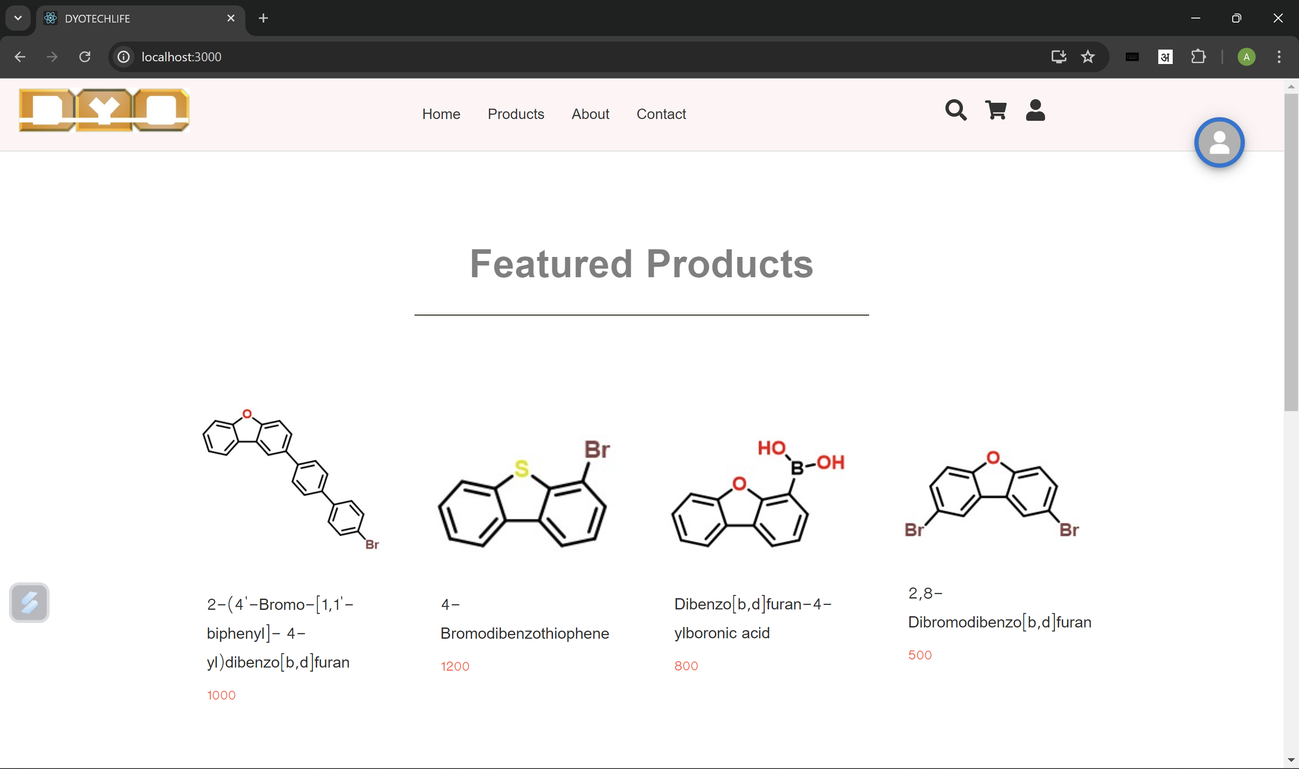
Home Page

Slide 3
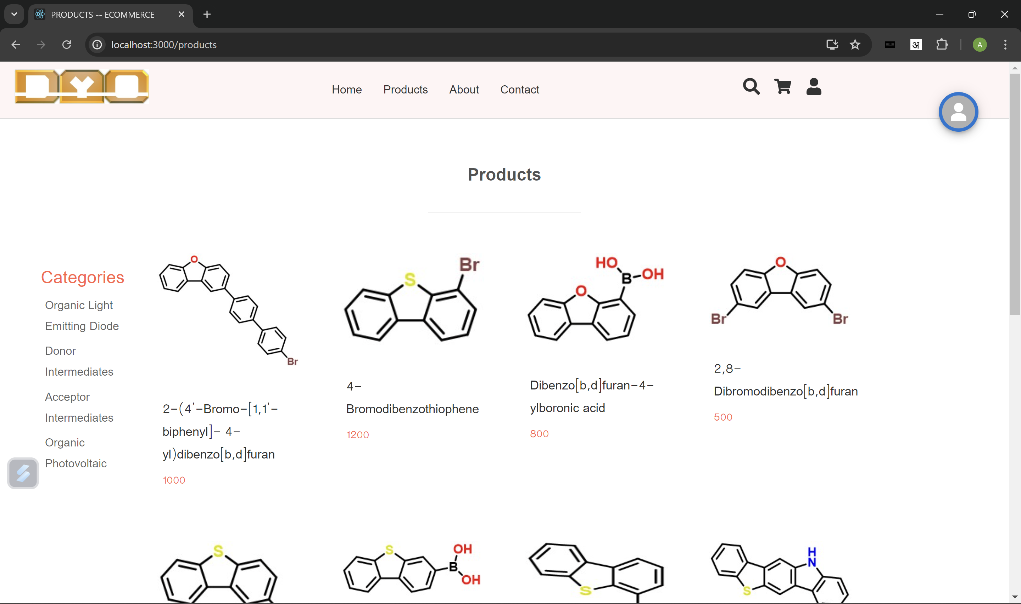
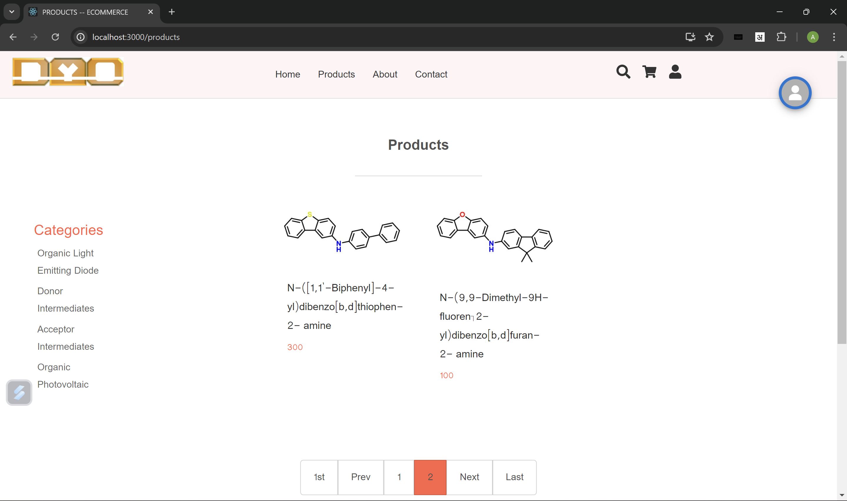
Products Page

Slide 4
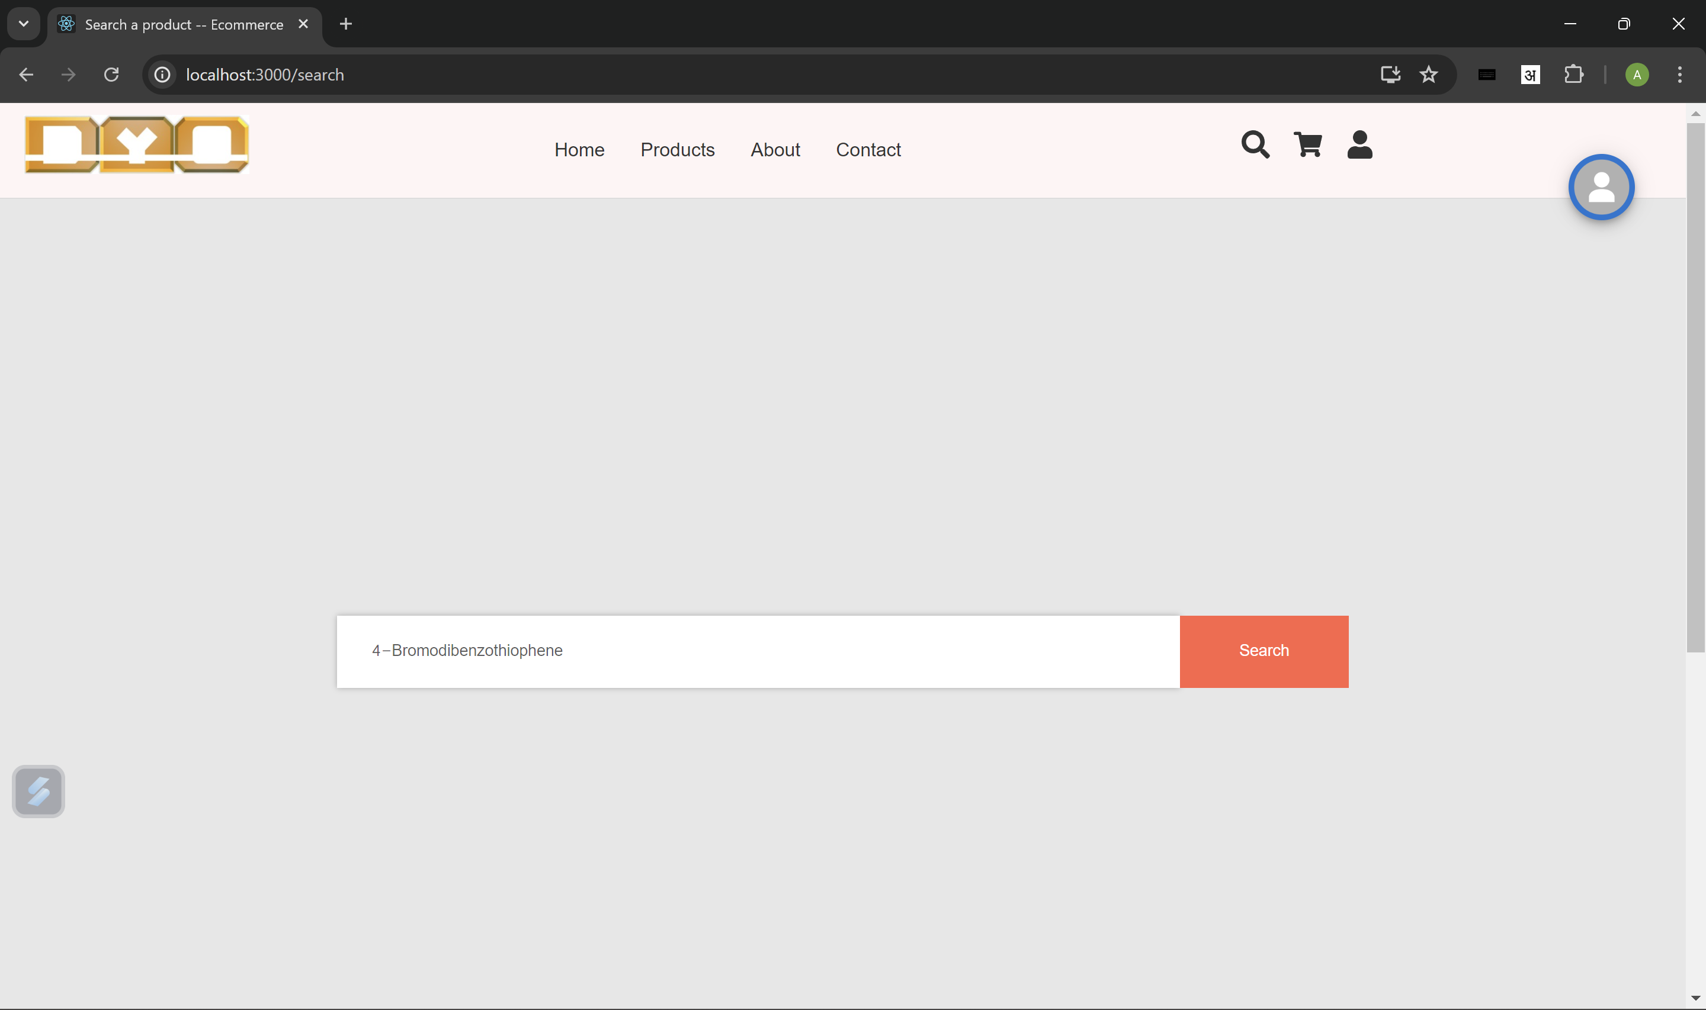
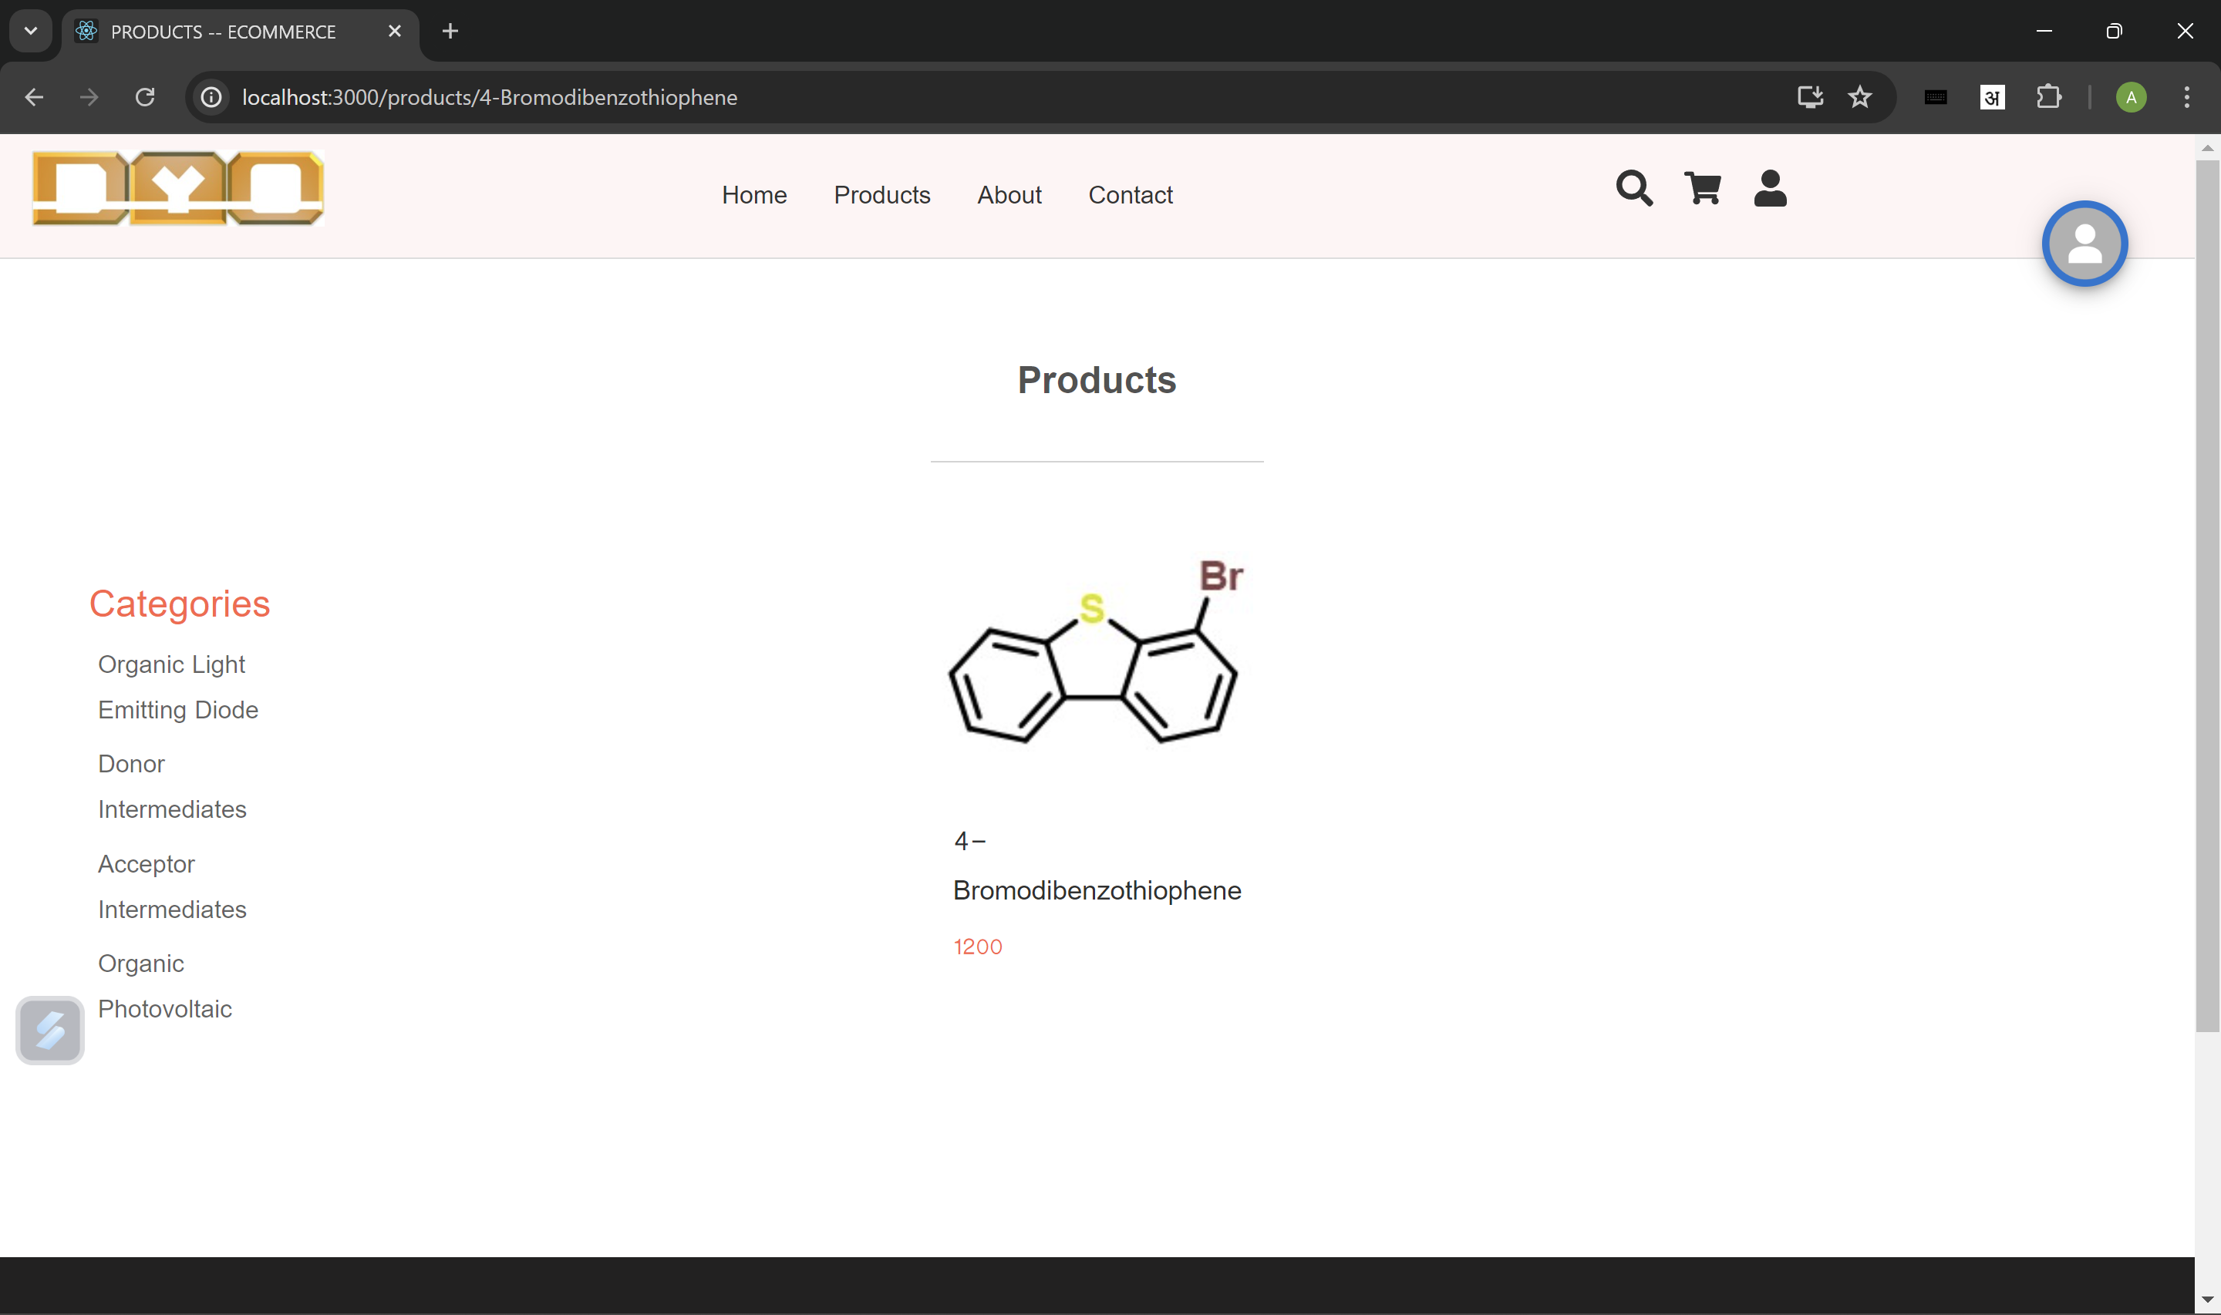
Search Icon Page
Search Page
Product Displayed

Slide 5
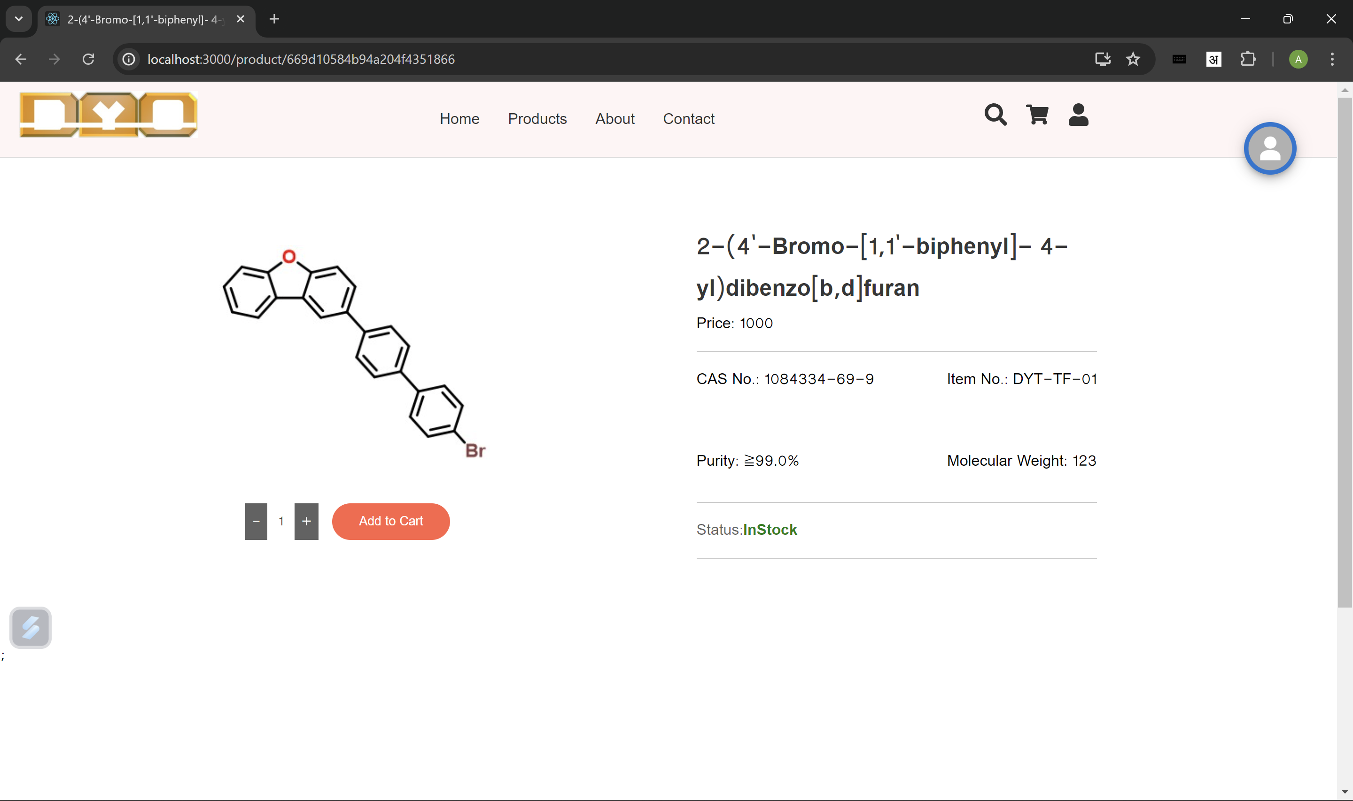
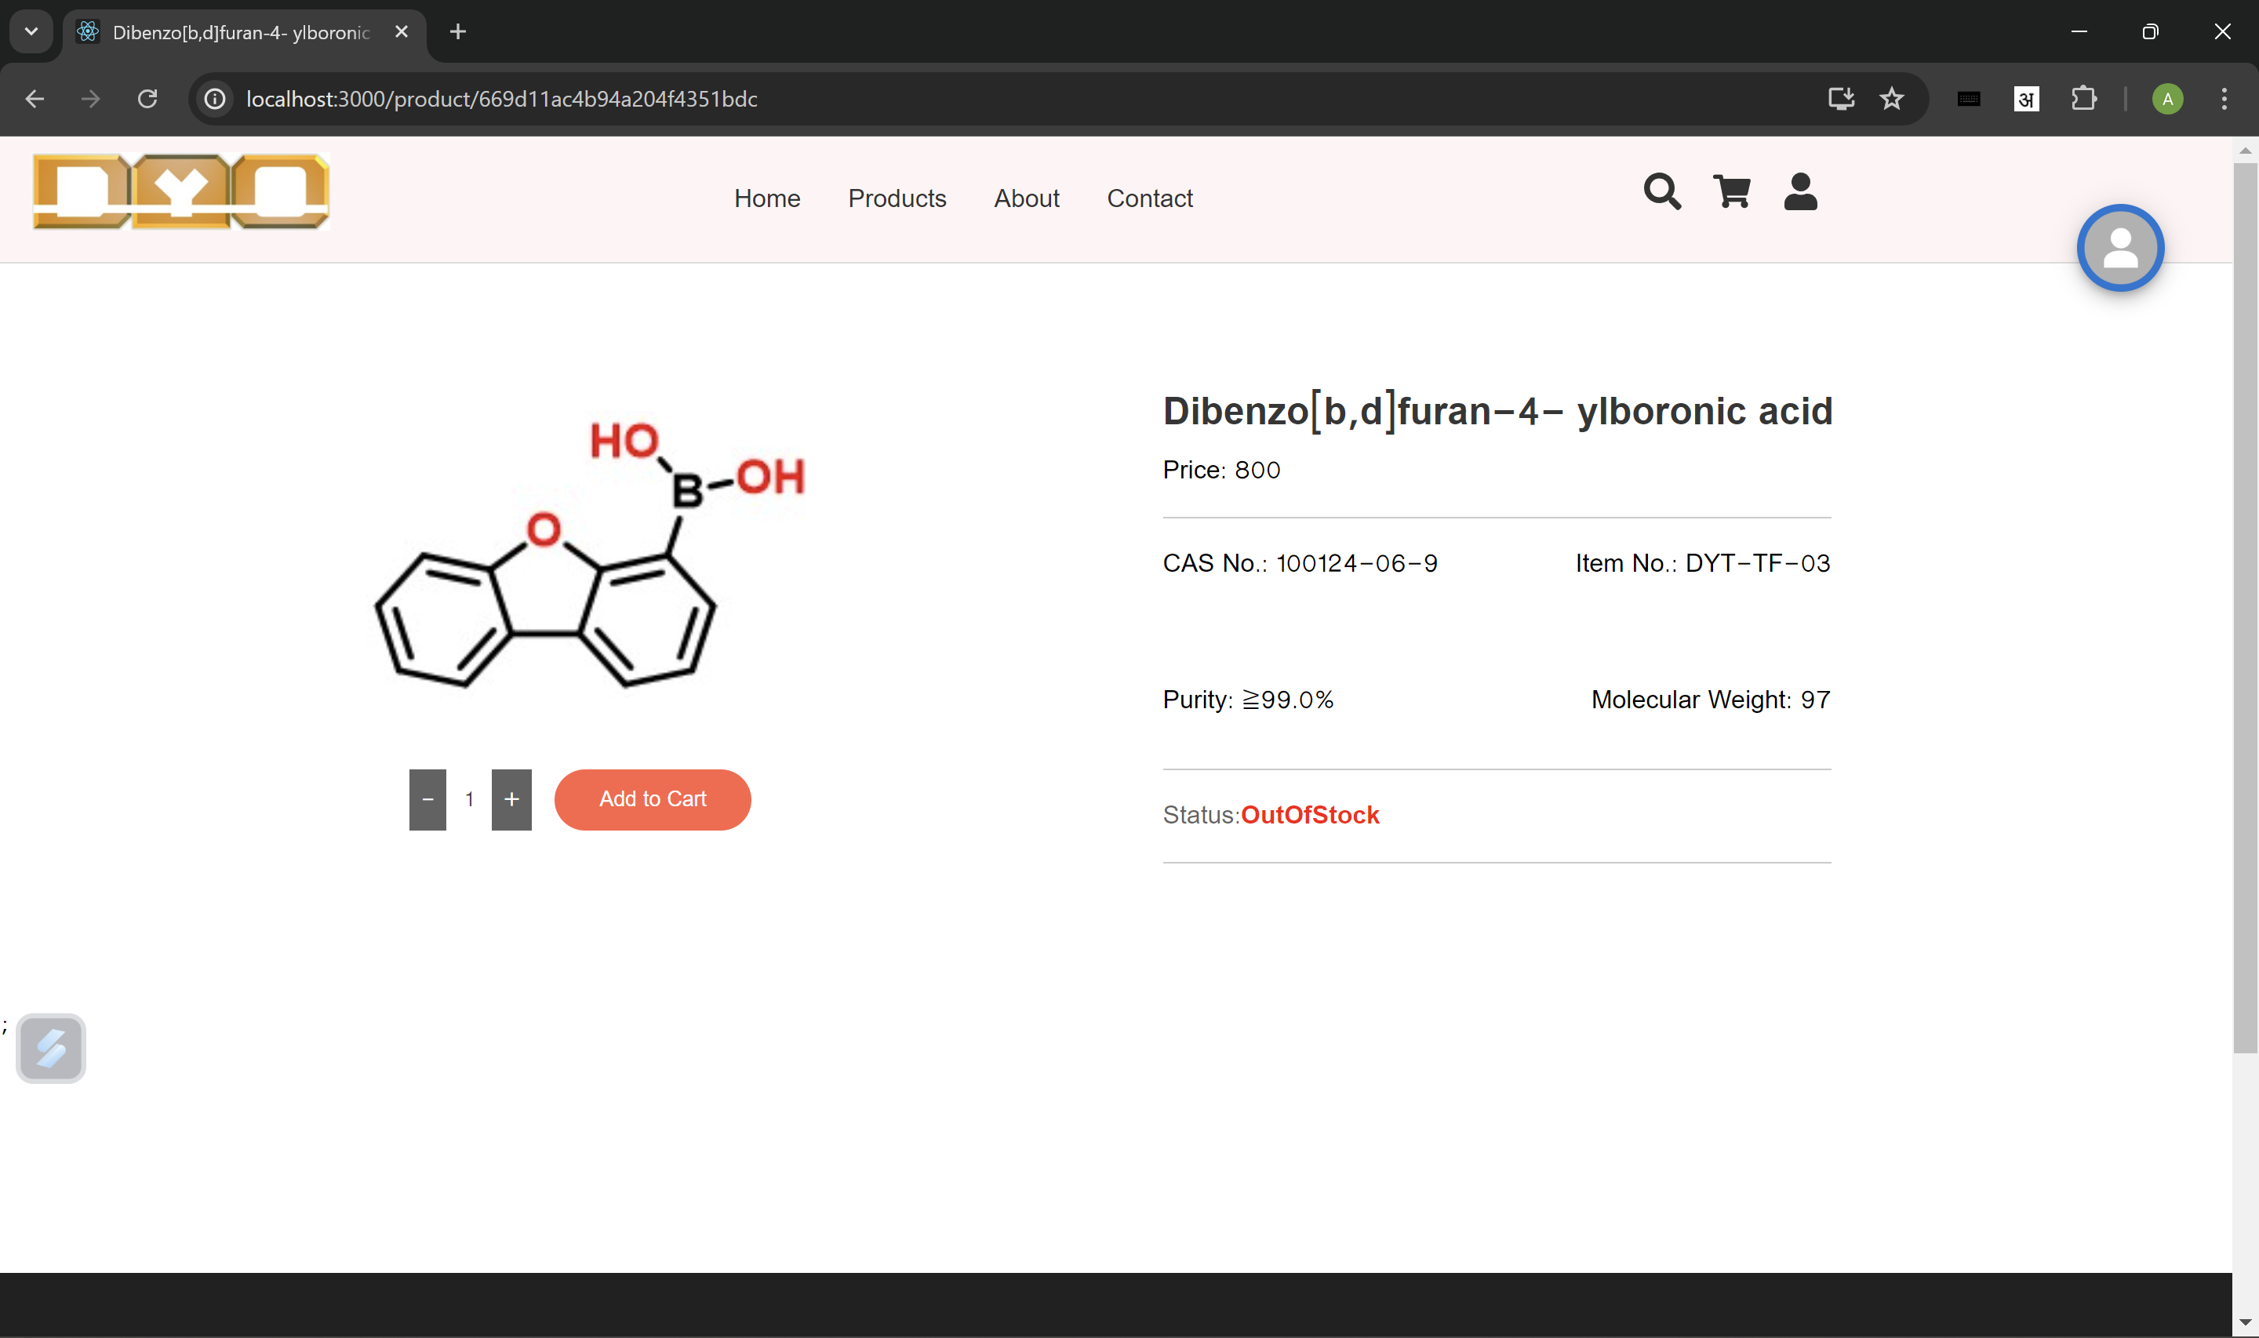
Product Details Page

Slide 6
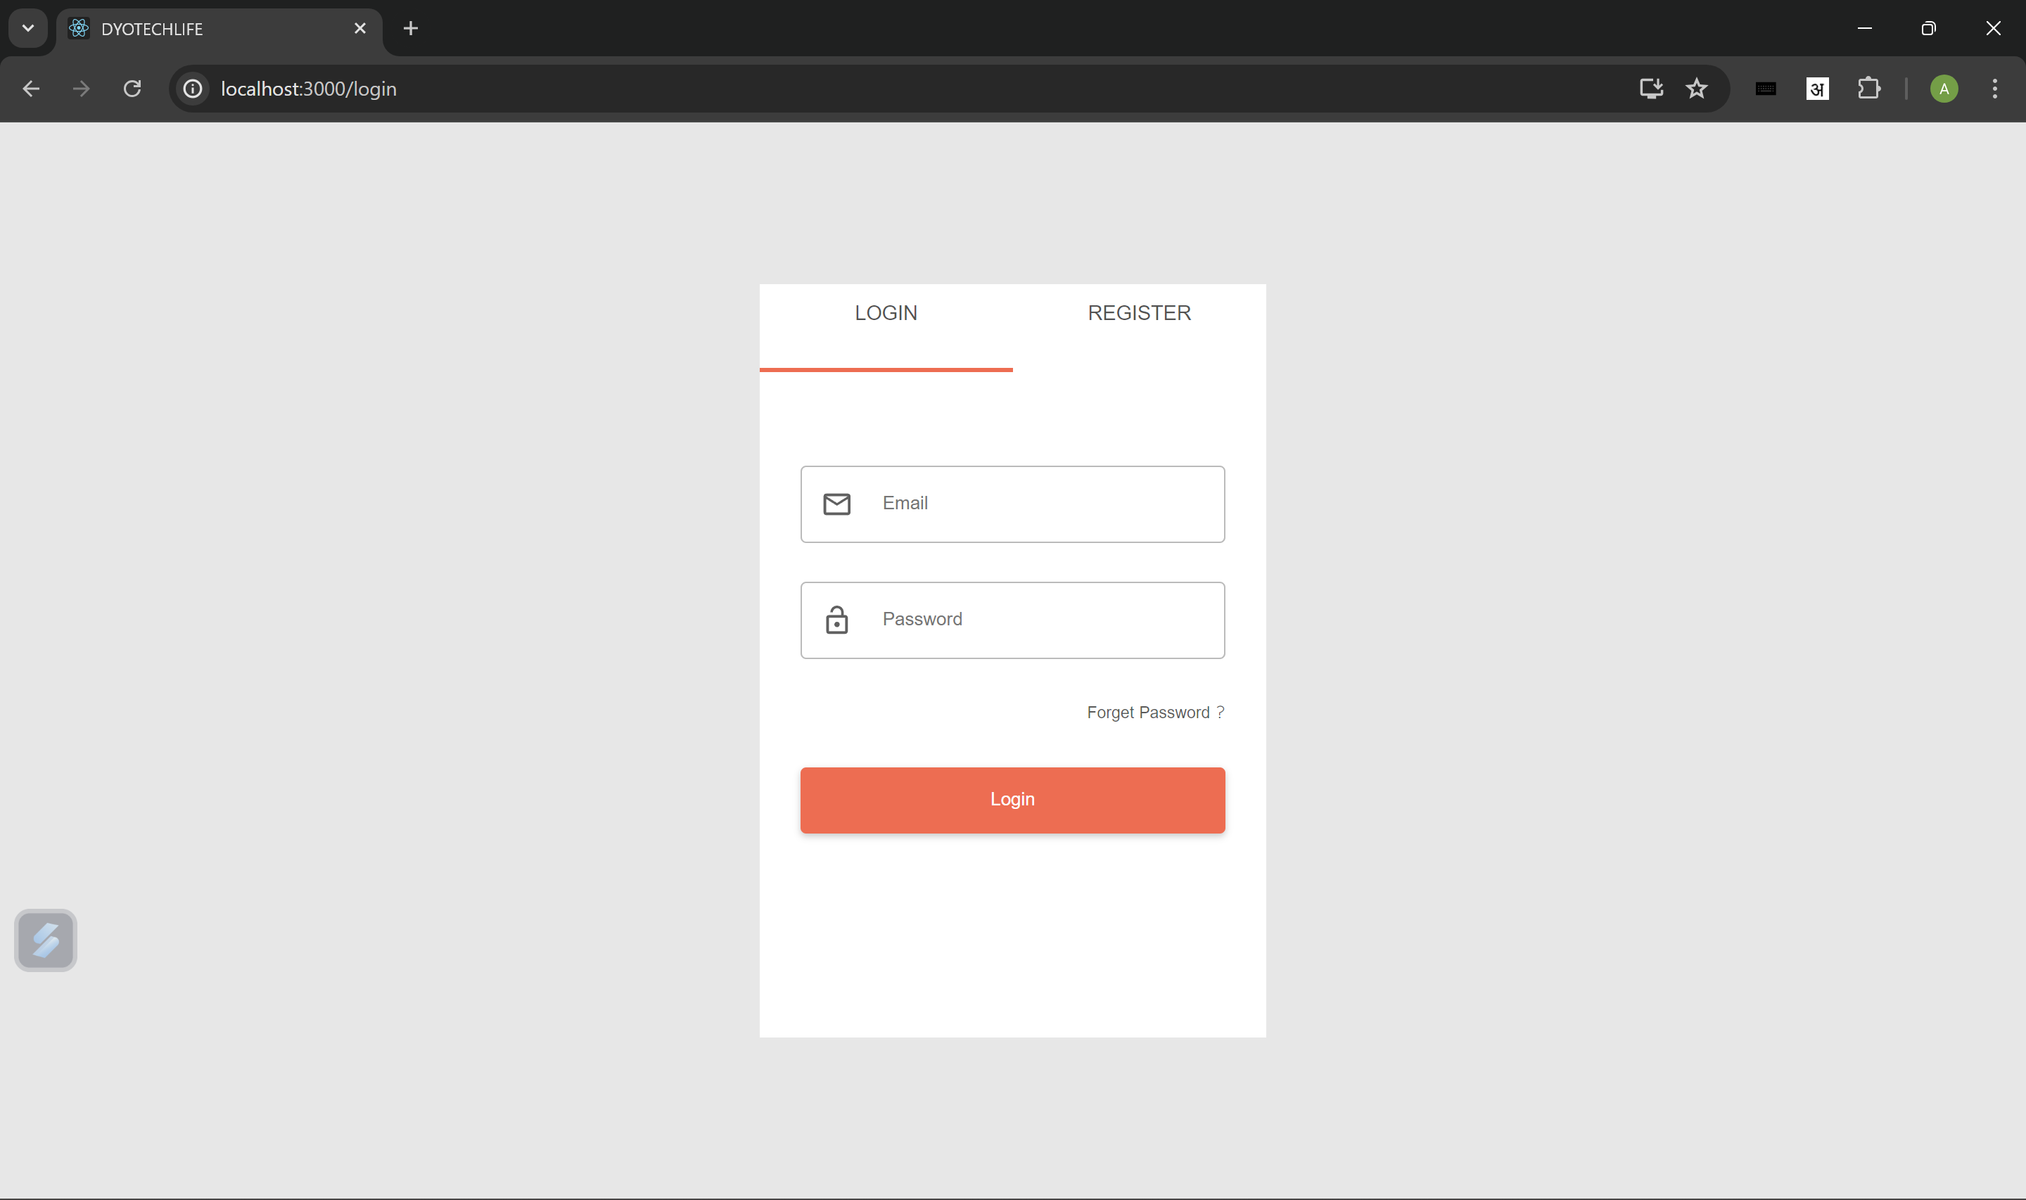
Login/Register Page

Slide 7
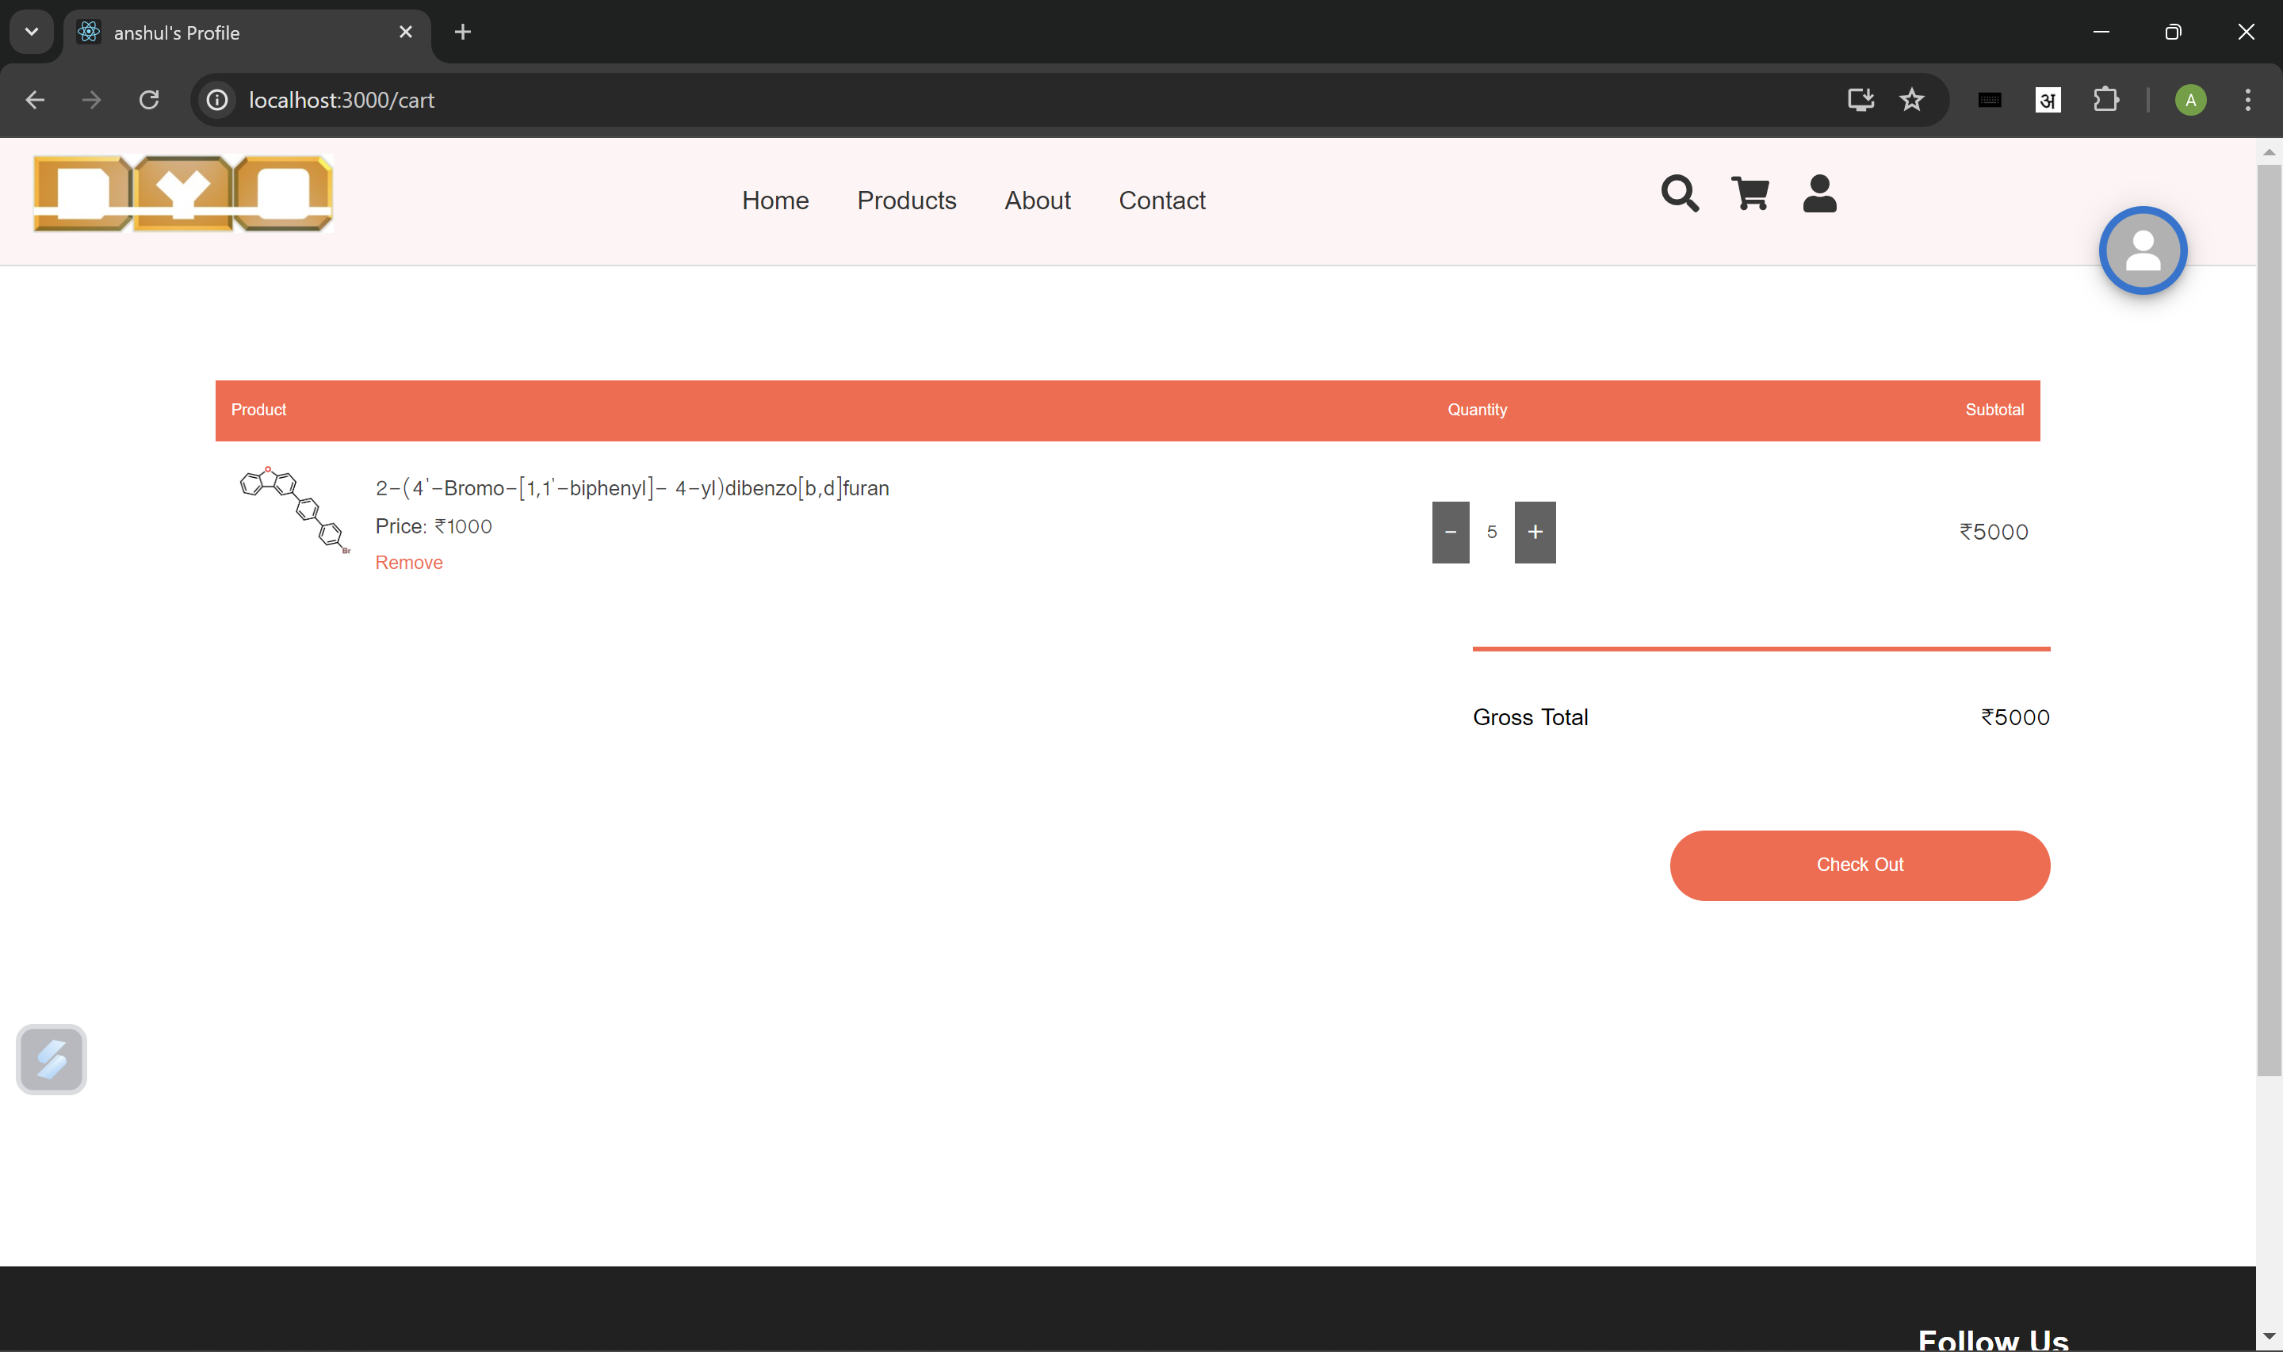
Cart Page

Slide 8
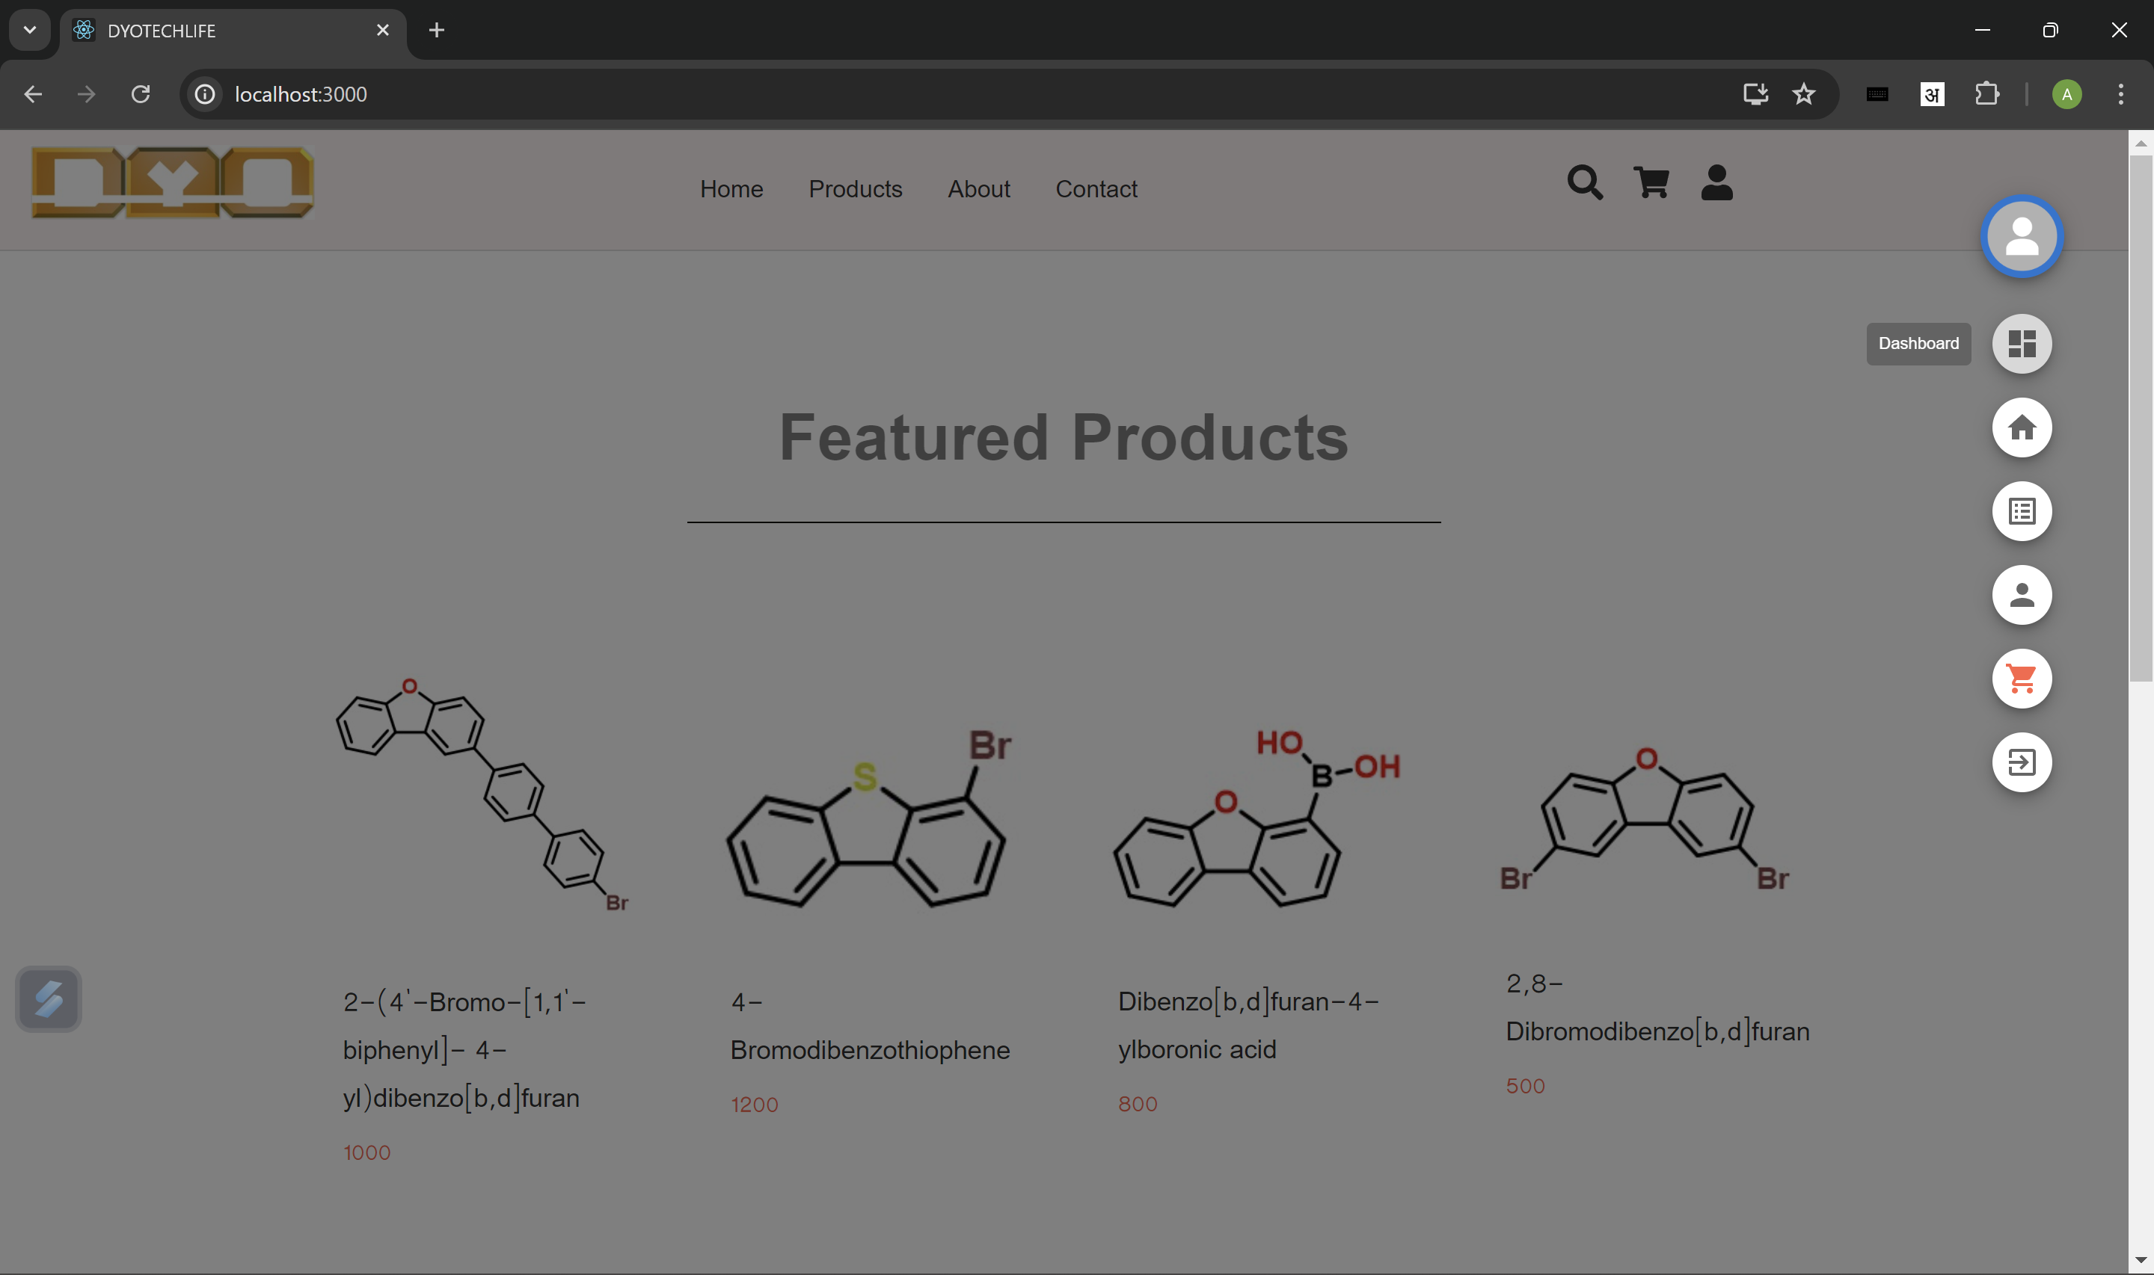
User Options
Dashboard – It contains all the features accessible to admin.
Home – Navigate to Home page.
Orders – Orders placed by User till now.
Profile – Navigate to User Profile page.
Cart – Navigate to Cart page.
Logout – User Logout from the Site.

Slide 9
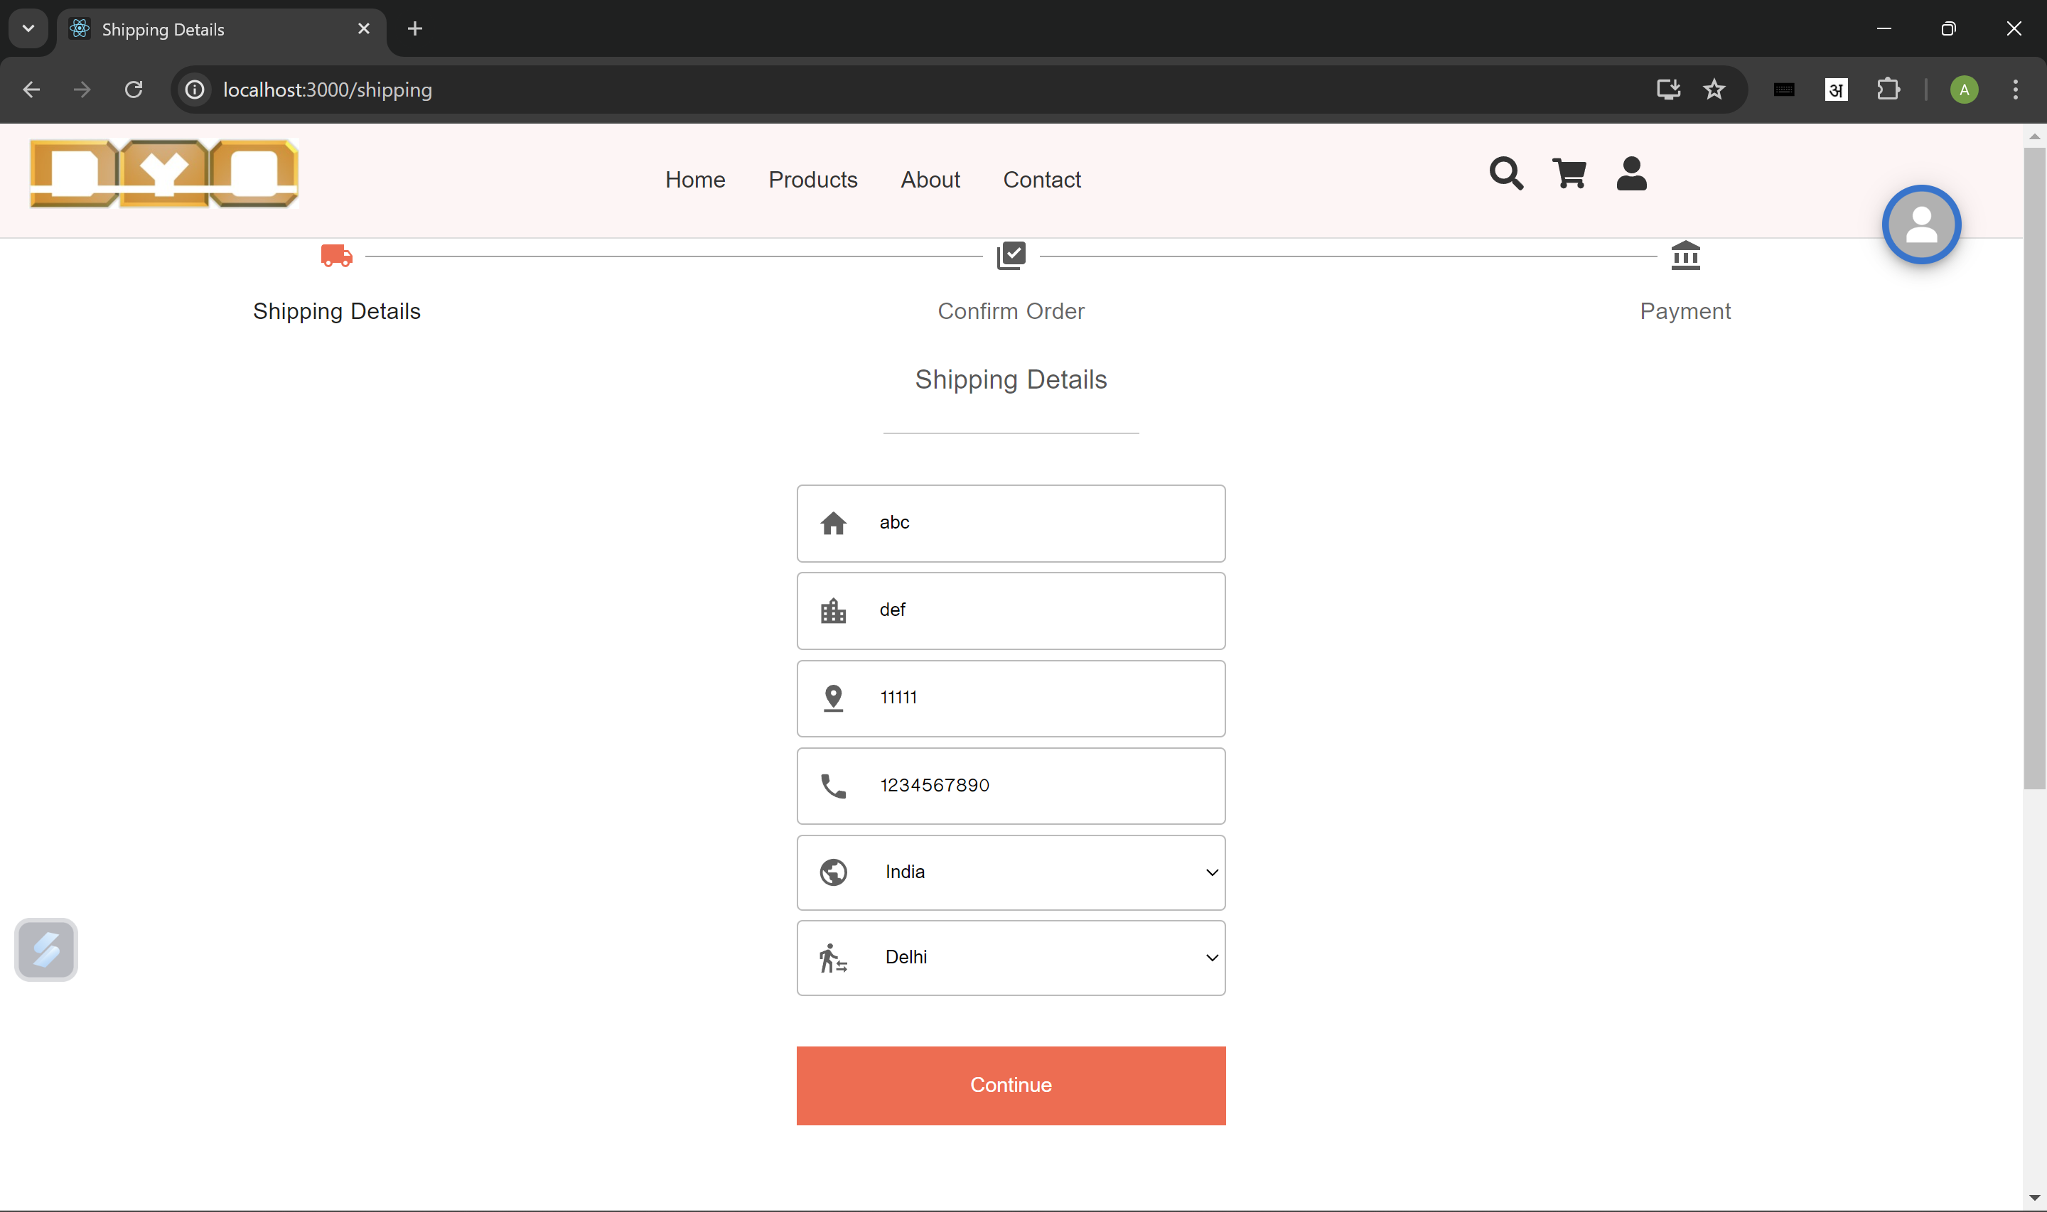
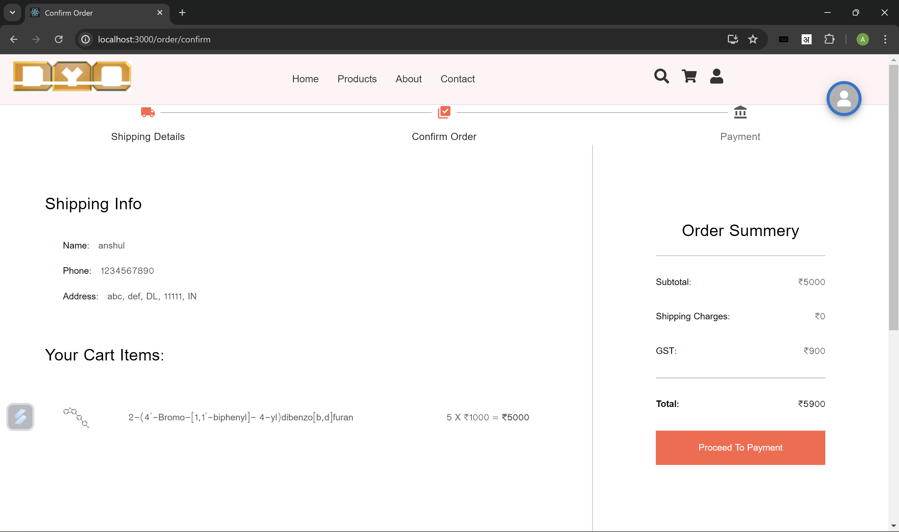
Shipping Details Page

Slide 10
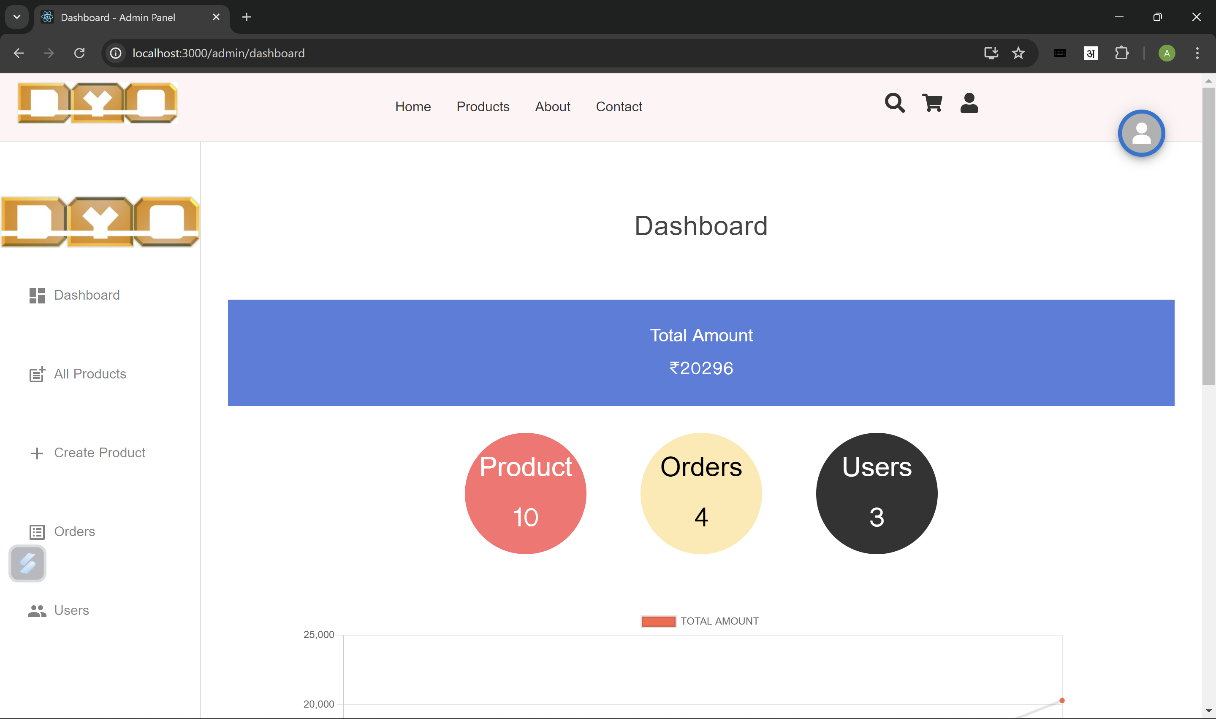
Dashboard – Admin Panel
On the left – All the Options Present such as –
All Products – To get all products.
Create Product – To Create a new Product.
Orders – Orders placed by all the users.
Users – Total registered users on the website.
The numbers has been displayed of total products, orders, and users.

Slide 11
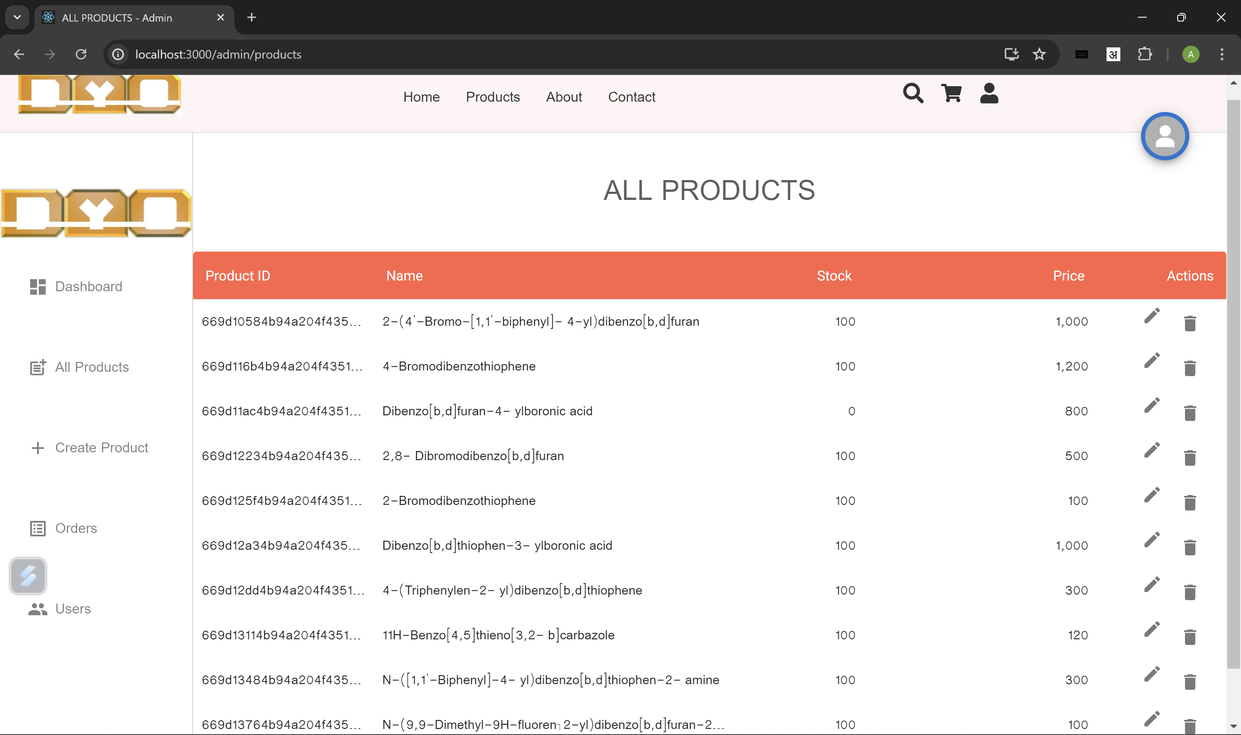
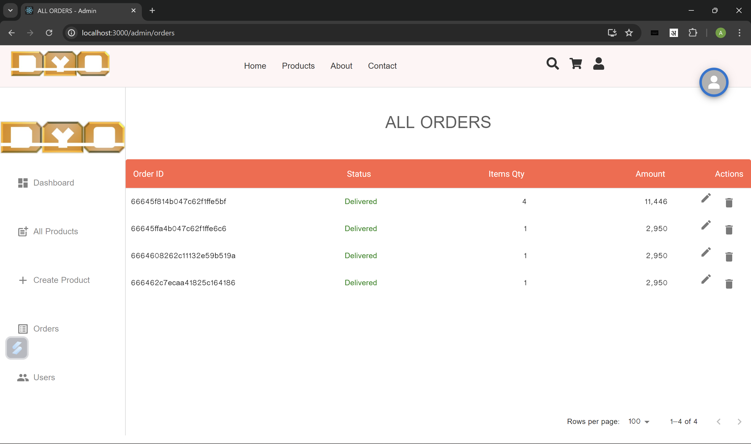
Admin Panel
All Products
All Orders

Slide 12
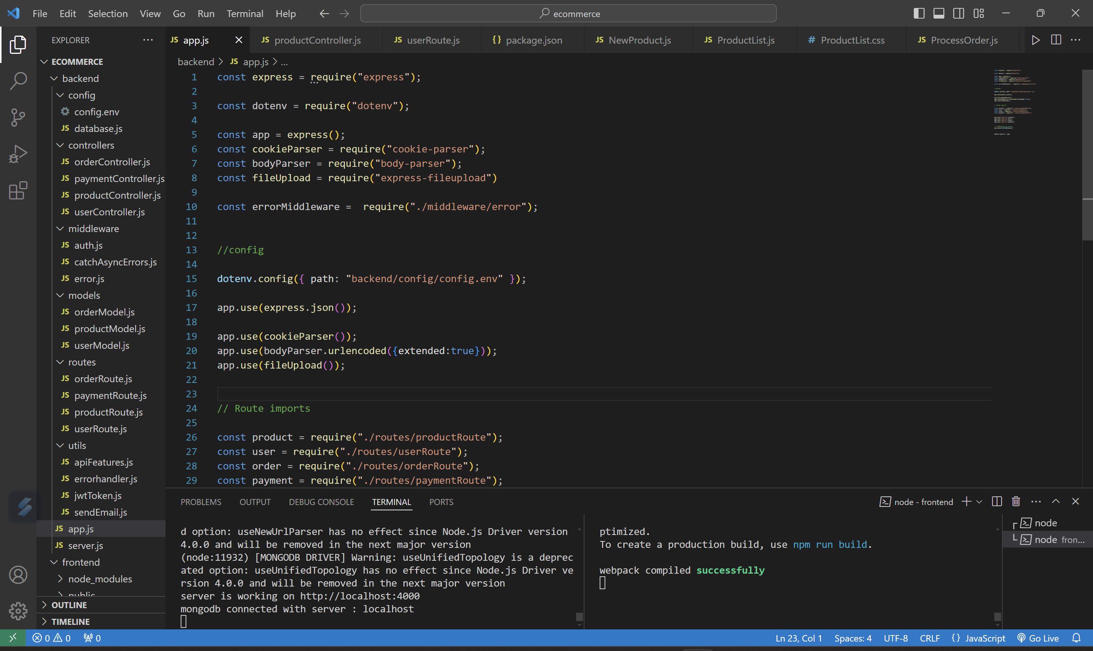
Backend Code

Slide 13
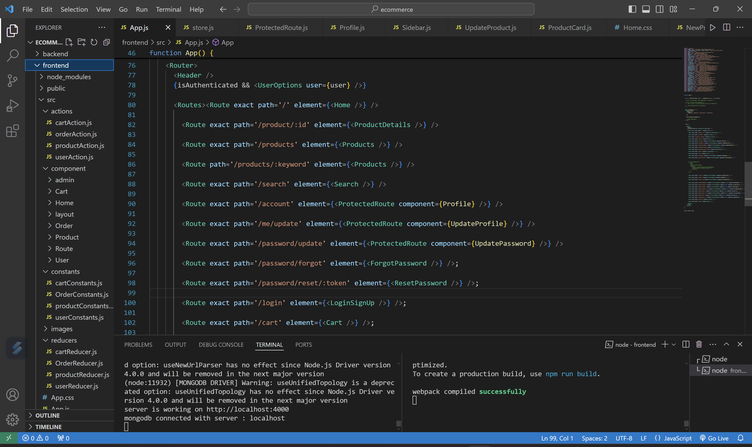
Frontend Code

